Slide 1
Automated Covariate-Model Building for Population PK
Nlmixr2 Ecosystem vs. NONMEM
Traditional SCM and cutting-edge VAE
Presenter: Yaping Liu (PMX intern)
Manager: Matt Fidler
Date: 08/18/2026

Slide 2
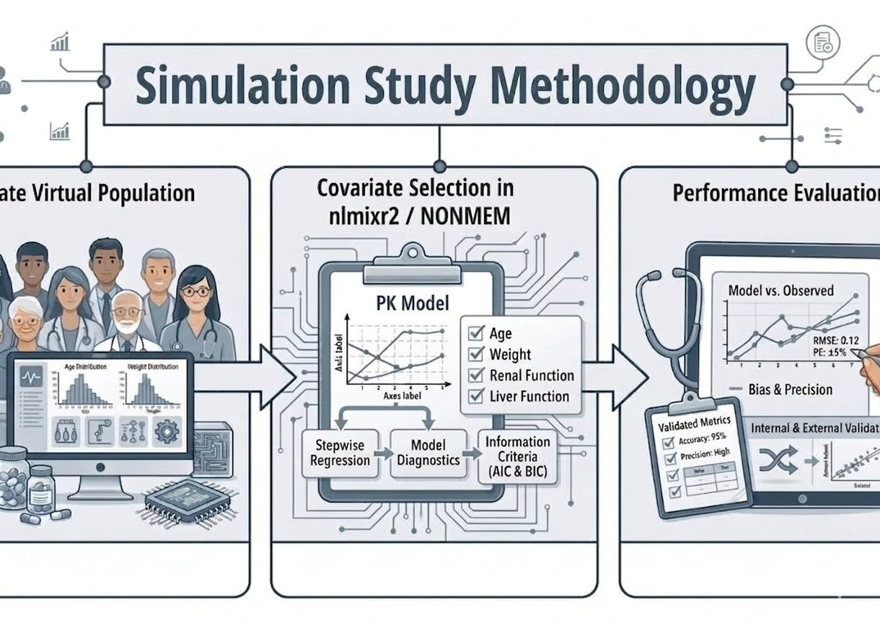
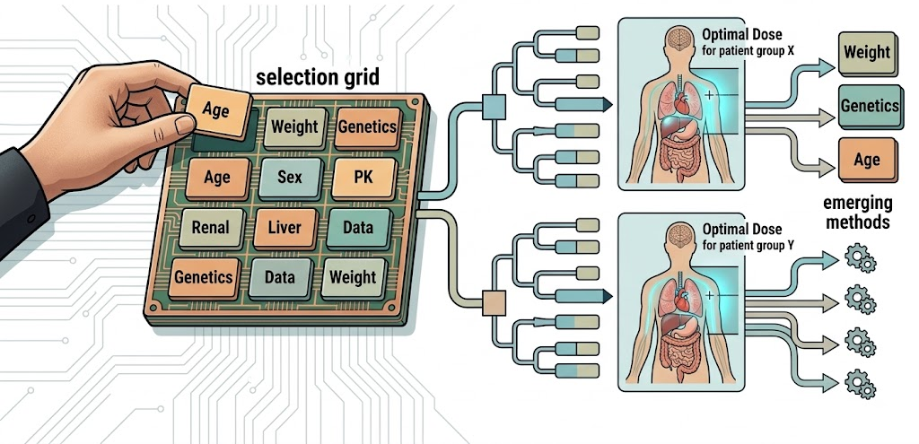
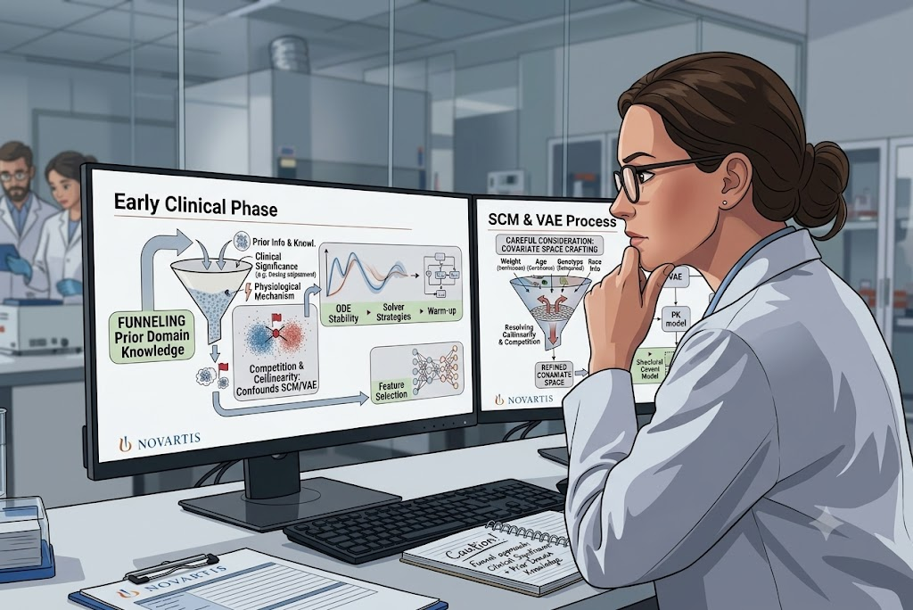





Roadmap
1. Covariate selection matters for dose optimization
2. Benchmark nlmixr2 vs. NONMEM
3. nlmixr2 matches NONMEM
4. Cautious interpretation & domain knowledge
$$≈$$
$$>$$

Slide 3
1 Background
2 Methods
3 Results
4 Discussion
3

Slide 4
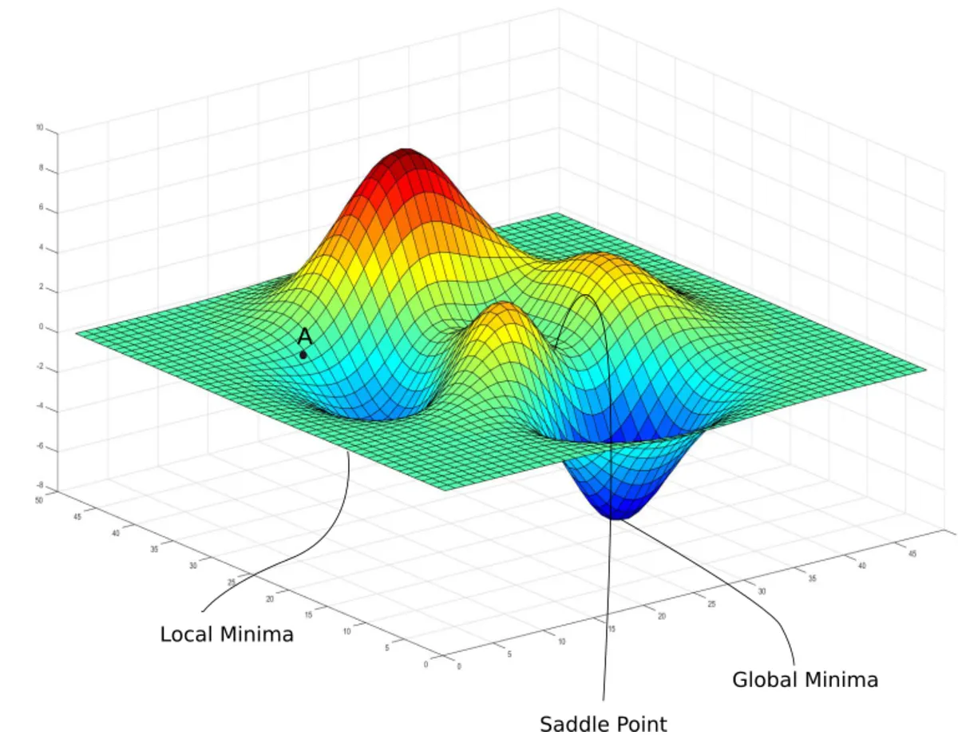
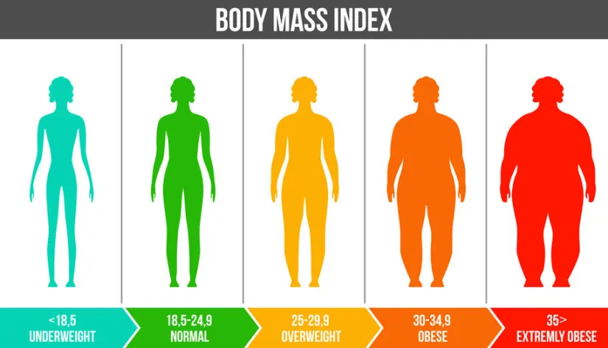

Population PK explains why drug exposure differs between patients
Nonlinear Mixed effect Models
Max(likelihood) Min(objective function)
Residual variability
C
Inter-individual variability
BW~CL
Time
https://pub.towardsai.net/from-probability-to-loss-how-mle-builds-machine-learning-part-1-52fe0efa43a9
4

Slide 5




The right covariates turn patient traits into Safer, more effective doses
Example — Warfarin
Narrow therapeutic narrow-therapeutic-index anticoagulant
Dose optimization
Clinical trial design
Clotting
Bleeding
Special-population labeling
CYP2C9 genotype, age, weight, comedication
Regulatory submissions
Br J Clin Pharmacol. 2012;73(1):66-76.
5

Slide 6

Traditional stepwise methods are FDA-ready,
with advanced methods emerging
SCM
Stepwise
COSSAC
Traditional
Full model
FREM
RF
Emerging Machine/Deep learning
VAE
CPT Pharmacometrics Syst Pharmacol. 2025;14(12):2232-2243.
Journal of Pharmacokinetics and Pharmacodynamics 34 (2007): 485–517.
Pharmaceutical Research 15 (1998): 1463–1468.
CPT: Pharmacometrics & Systems Pharmacology, 2025; 14:621–639

Slide 7
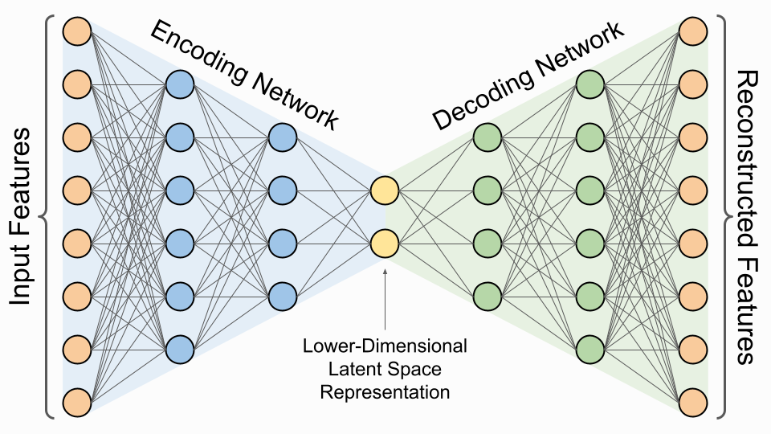
SCM builds the model by adding, then pruning, covariates one at a time
Forward inclusion
Backward elimination
Yes (add, repeat)
Yes (remove, repeat)
LRT
p < 0.05?
p > 0.01?
Base model
Add the most significant
candidate
Remove weakest
Final
model
No
No
VAE can estimate population parameters and covariate effects in a single run
Pharmaceutical Research 15 (1998): 1463–1468.
7

Slide 8
We benchmark nlmixr2's SCM and VAE against the NONMEM standard
To evaluate the operating characteristics of traditional (i.e., SCM) and novel (i.e., VAE) covariate model building methods in the open-source nlmixr2 ecosystem, benchmarking against PsN-NONMEM-SCM.
8

Slide 9
1 Background
2 Methods
3 Results
4 Discussion
9

Slide 10
Identical simulated data feeds all three workflows for a fair test
1
2
3
Simulate
virtual population
Build
covariate models
Evaluate
operating characteristics
NHANES
Base model
Winner vs. True model
+
Nlmixr2
Reliability
True PopPK
Full model
covariates
VAE
Power
SCM
Accuracy
Nonmem
Efficiency
Winner model
Paired Statistical Test
3 sample size * 2 model parameterization* 16 scenarios * 100 datasets * 3 workflows = 28,800 tasks
10

Slide 11
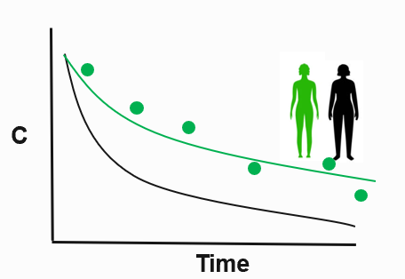
Simulate virtual populations with realistic covariate correlation & PK
1
2
Dose
NHANES
Ka
Vp
Q
Vc
CL
Stratified
Bootstrap
N= 300
N= 80
N= 40
|delta_correlation| < 0.05
Cohort, Dataset, ID, Wt, BMI, CrCL, Sex, Race
Scenario, Time, Dose, Concentration
J Pharmacokinet Pharmacodyn. 2019;46(3):273-285.
11

Slide 12
Design 16 scenarios with easy → complex covariate effects from the overall covariate space
Overall covariate space
Power
Linear
Wt
Sex
Wt
Vc
Vc
Wt
Base Model (No covariate)
BMI
Full Model
BMI
CL
CL
CrCl
Wt
CrCl
CrCl
Categorical
Scenario 1
(Easiest)
Scenario 16
(Most complex)
Scn2-15
Race
Sex
(16 combinations in total)
J Pharmacokinet Pharmacodyn. 2019;46(3):273-285.
12

Slide 13
Set up three workflows for benchmarking
 | Nlmixr2-SCM | PsN-SCM | Nlmixr2-VAE
Model type | lincmt (analytic) ODE | ADVAN4 (analytic) ADVAN13 (ODE) | lincmt (analytic) ODE
Estimator | FOCEI | FOCEI | VAE
Convergence-related settings | Sigdig =4 Tol=1e-6 Atol=1e-8 | Sigdig =4 Tol=1e-6 Atol=1e-8 | Sigdig =4 Tol=1e-6 Atol=1e-8
LRT criteria | Forward p<0.05 / Backward p<0.01 | Forward p<0.05/ Backward p<0.01 | N.A.
Warm Start | Yes | N.A. | N.A.
Parallelism | HPCE/CPU core = 4 | HPCE/CPU core = 4 | HPCE/CPU core = 4
N.A., not applicable
13

Slide 14
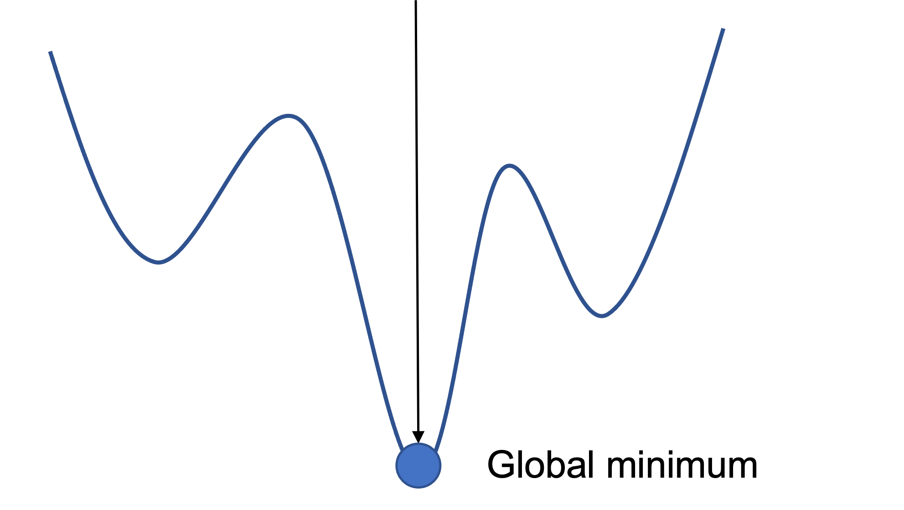
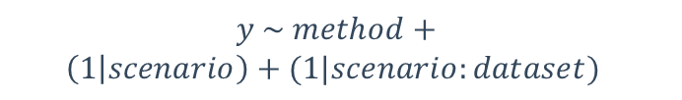


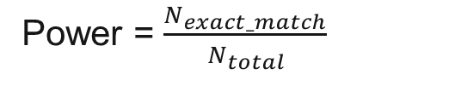

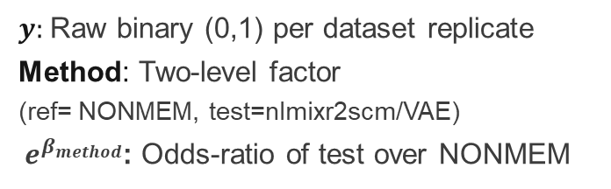

Four operating characteristics score every method
1
2
Primary statistical test
paired mixed-effects model
Model Reliability
Power (Exact match)
Convergence
Power = $\frac{N_{exact_match}}{N_{total}}$
$$y \sim method+$$
$$\left(1 | scenario\right)+(1|scenario:dataset)$$
${\text{Power}}_{MinSuc}$ = $\frac{N_{exact_match}}{N_{total}}$
$y:$Raw binary (0,1) per dataset replicate
Method: Two-level factor (ref= NONMEM, test=nlmixr2scm/VAE)
$e^{β_{method}}$: Odds-ratio of test over NONMEM
$$MinSuc$$
${\text{Power}}_{CN}$ = $\frac{N_{exact_match}}{N_{total}}$
$$\#CN<1000$$
Condition Number
nlmixr2&NONMEM
Fallback: exact McNemarTest
#CN ≤ 1000
Under ceiling / separation (e.g., Convergence rates pinned at 100%)
14

Slide 15
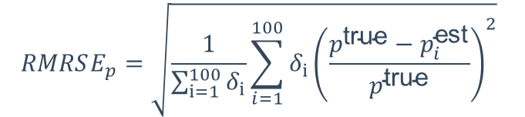
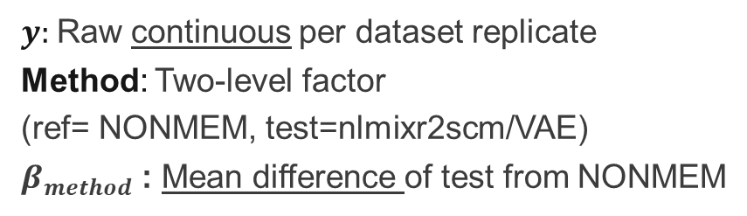
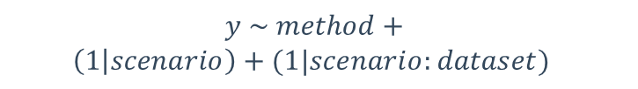
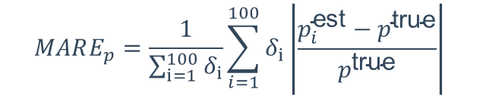
Four operating characteristics score every method
3
Estimation accuracy
Primary statistical test
paired mixed-effects model
RMRSE — outlier-sensitive
$$RMRSE_{p}=\sqrt{\frac{1}{\sum_{i=1}^{100}{δ_{i}}}\sum_{i=1}^{100}{δ_{i}{\left(\frac{p^{\text{true}}−p_{i}^{\text{est}}}{p^{\text{true}}}\right)}^{2}}}$$
$$y \sim method+$$
$$\left(1 | scenario\right)+(1|scenario:dataset)$$
MARE — robust
$y:$Raw continuous per dataset replicate
Method: Two-level factor (ref= NONMEM, test=nlmixr2scm/VAE)
$β_{method}$: Mean difference of test from NONMEM
$$MARE_{p}=\frac{1}{\sum_{i=1}^{100}{δ_{i}}}\sum_{i=1}^{100}{δ_{i}\left|\frac{p_{i}^{\text{est}}−p^{\text{true}}}{p^{\text{true}}}\right|}$$
$$δ_{i}=1, exact_{match};0 otherwise$$
4
Run-time
Practical-equivalence band: relative change over NONMEM >=10%
HPCE CPU core=4

Slide 16


$$≈$$
$$>$$
1 Background
2 Methods
3 Results
4 Discussion
16

Slide 17
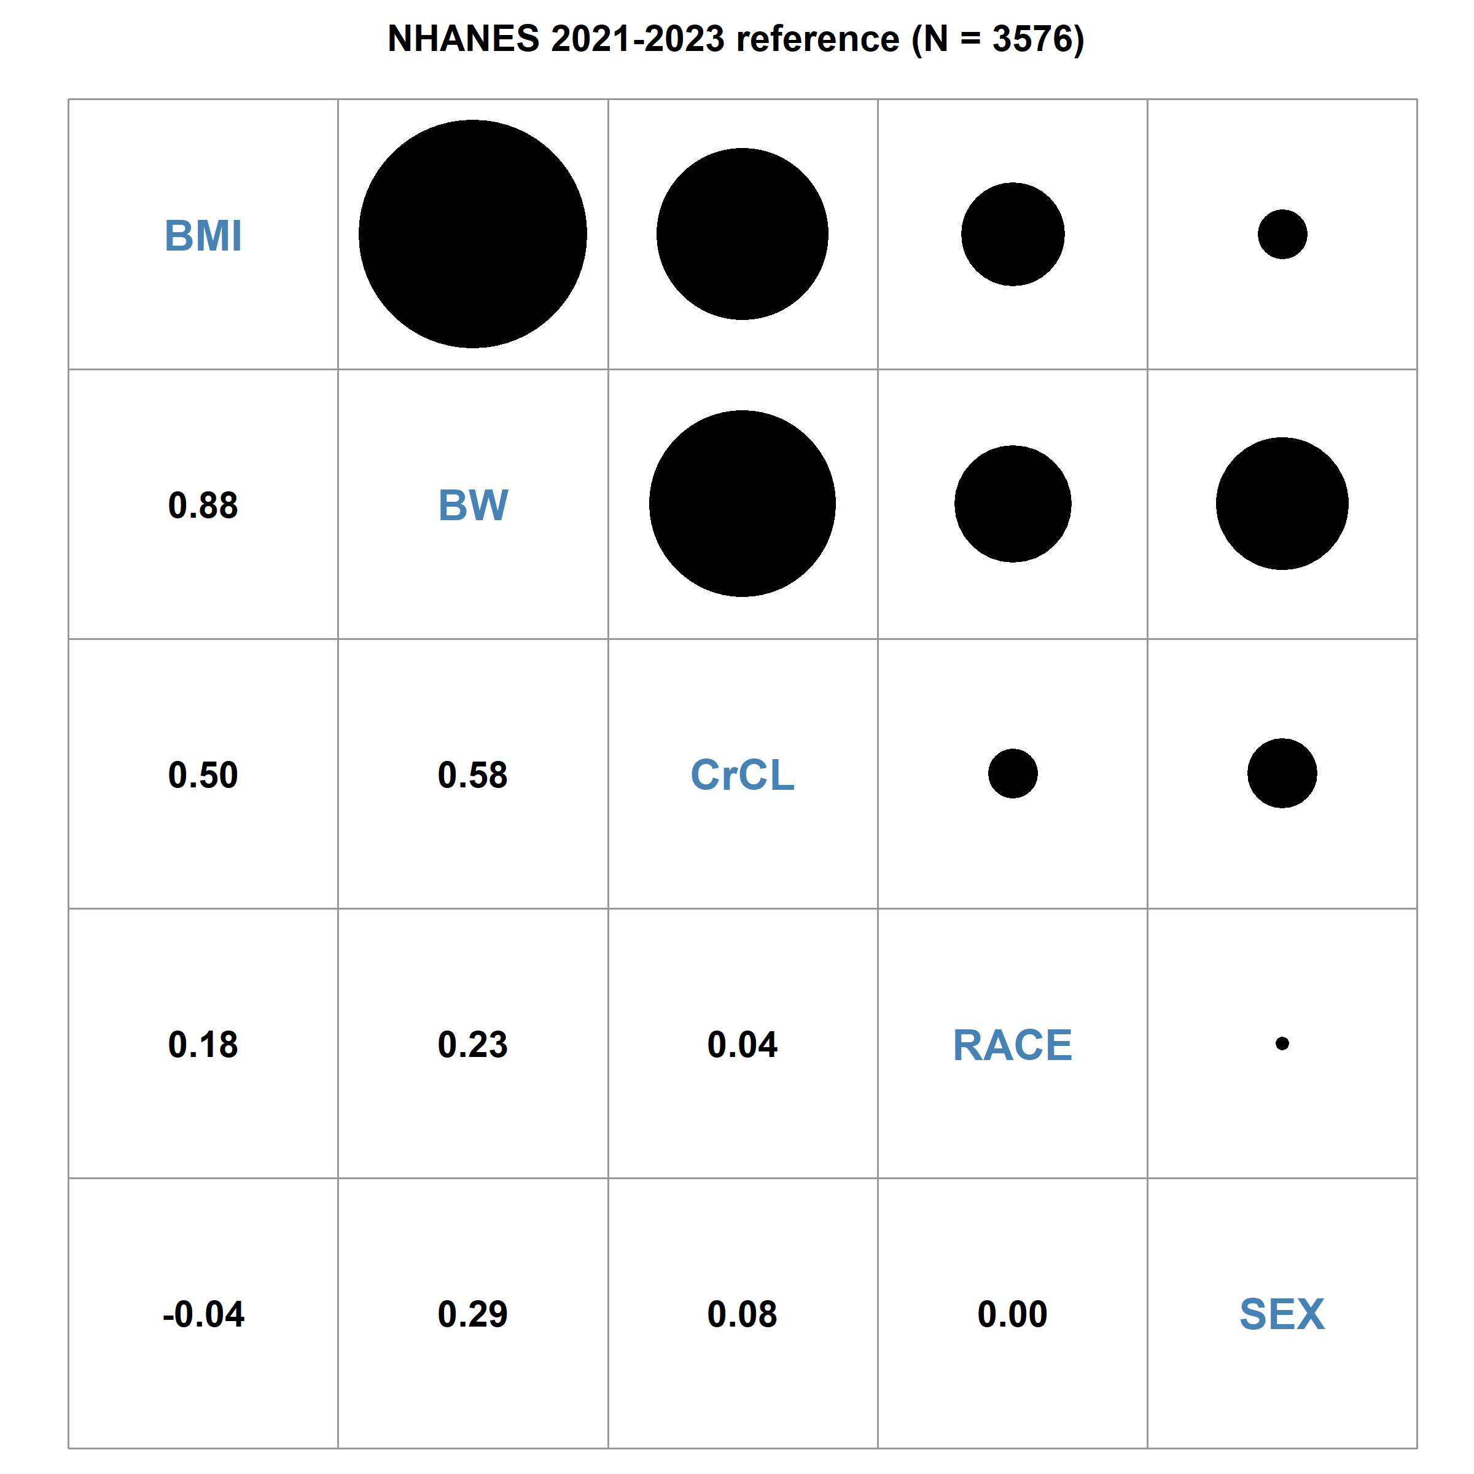

Simulated datasets retained the correlation structure from NHAENS
Weight and BMI are highly collinear — a selection trap

Slide 18
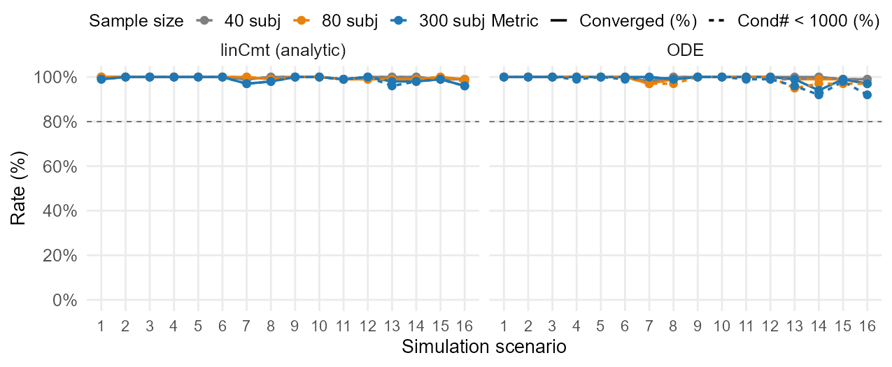
nlmixr2 SCM converges reliably in both analytic and ODE forms
Nlmixr2 SCM
High convergence rate and condition number <1000 for both analytic and ODE setting
1 Reliability
2 Power
3 Accuracy
4 Runtime
18

Slide 19
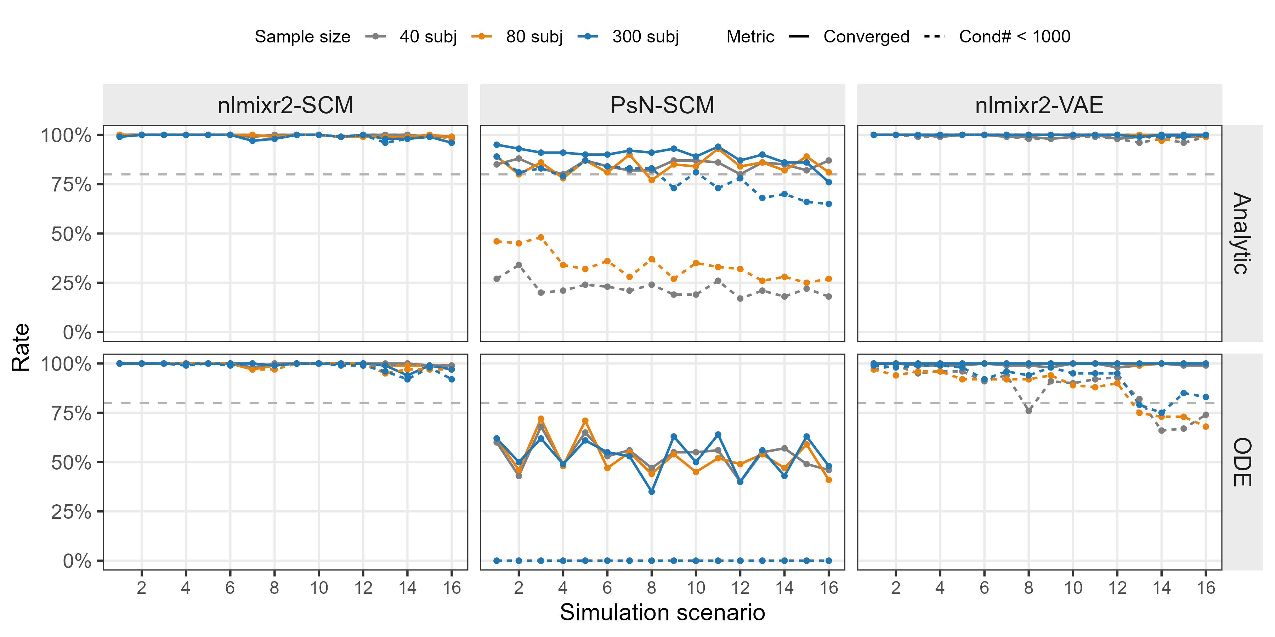
nlmixr2 matches or exceeds NONMEM on convergence & cov_step
1 Reliability
2 Power
3 Accuracy
4 Runtime

Slide 20
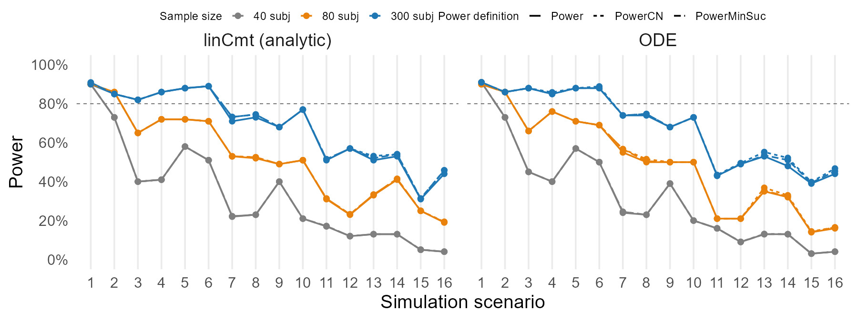

Power rises with sample size and falls with model complexity
nlmixr2 SCM
Lincmt $≈$ODE
N ↓, Power ↓
1 Reliability
2 Power
3 Accuracy
4 Runtime
20

Slide 21
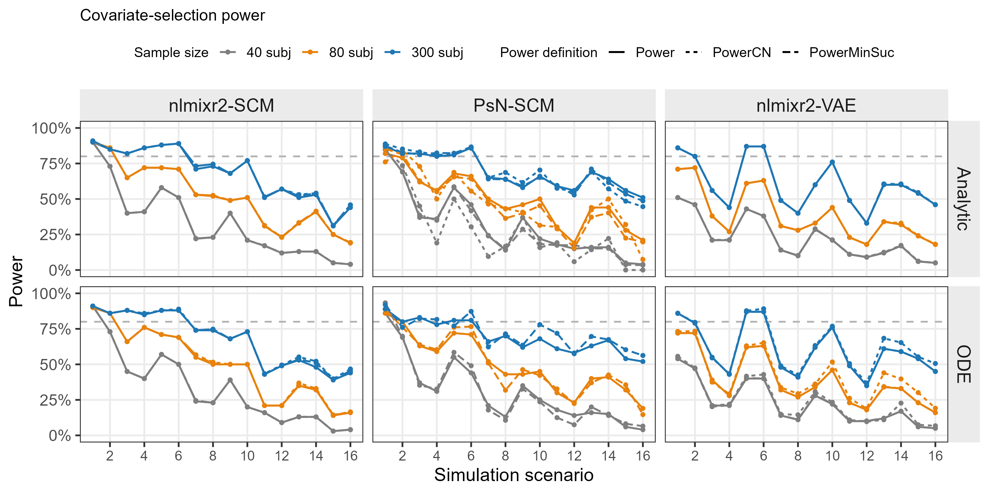
SCM power is comparable across nlmixr2 and NONMEM, and ≥ VAE
Median of power over 16 scenarios
73%
66%
58%
33%
50%
45%
Power & linear
23%
23%
19%
BW vs. BMI
1 Reliability
2 Power
3 Accuracy
4 Runtime
21

Slide 22
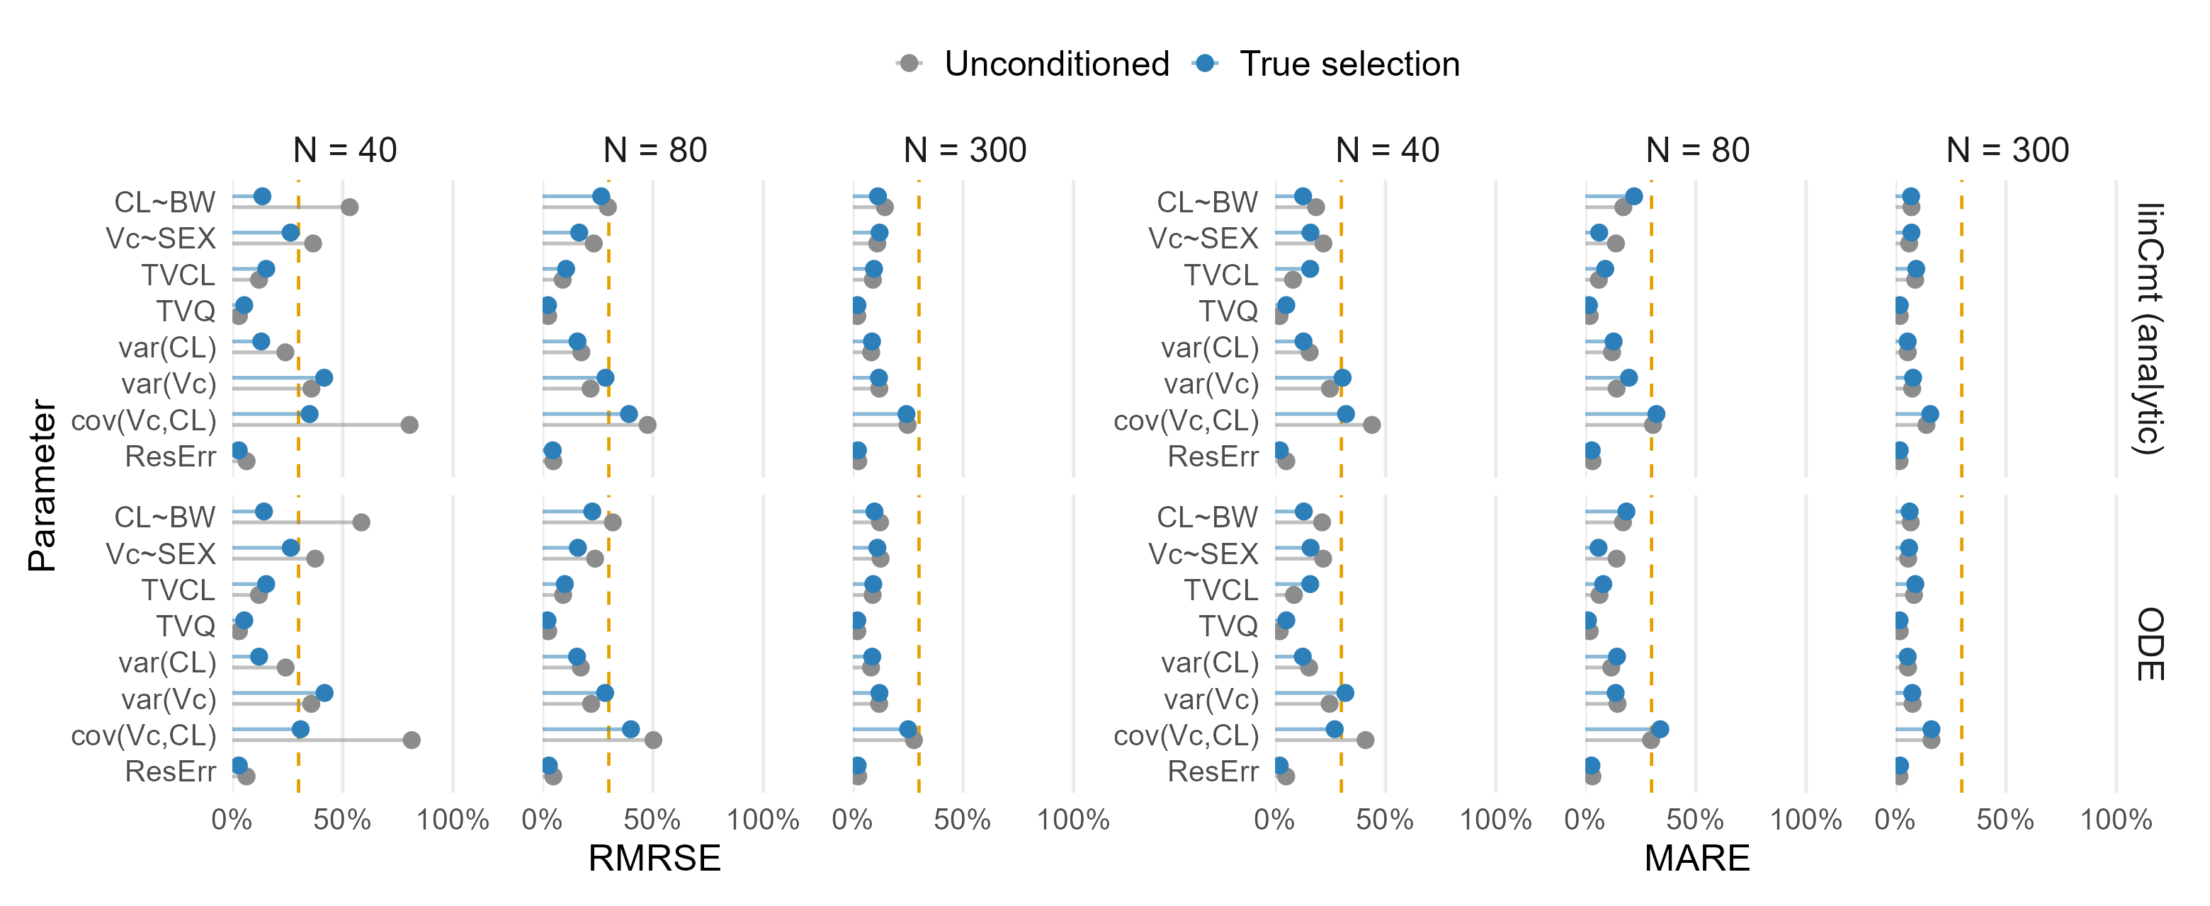

Covariate-effect errors are low; variance terms are the hard part
Nlmixr2 SCM
Lincmt $≈$ODE
N ↓, RMRSE & MARE ↑
Estimation difficulty: covariance> variance > covariate effect > typical value
1 Reliability
2 Power
3 Accuracy
4 Runtime
22

Slide 23
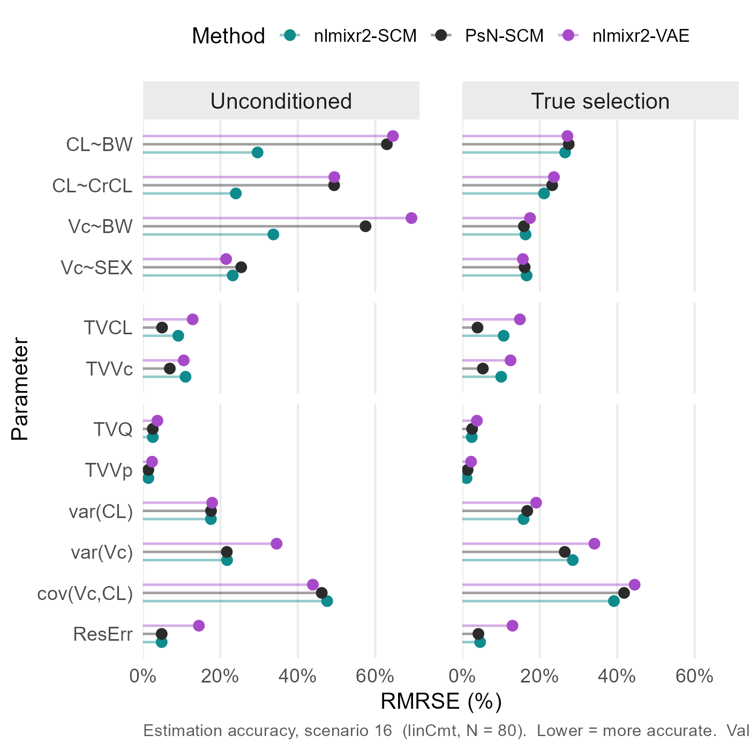
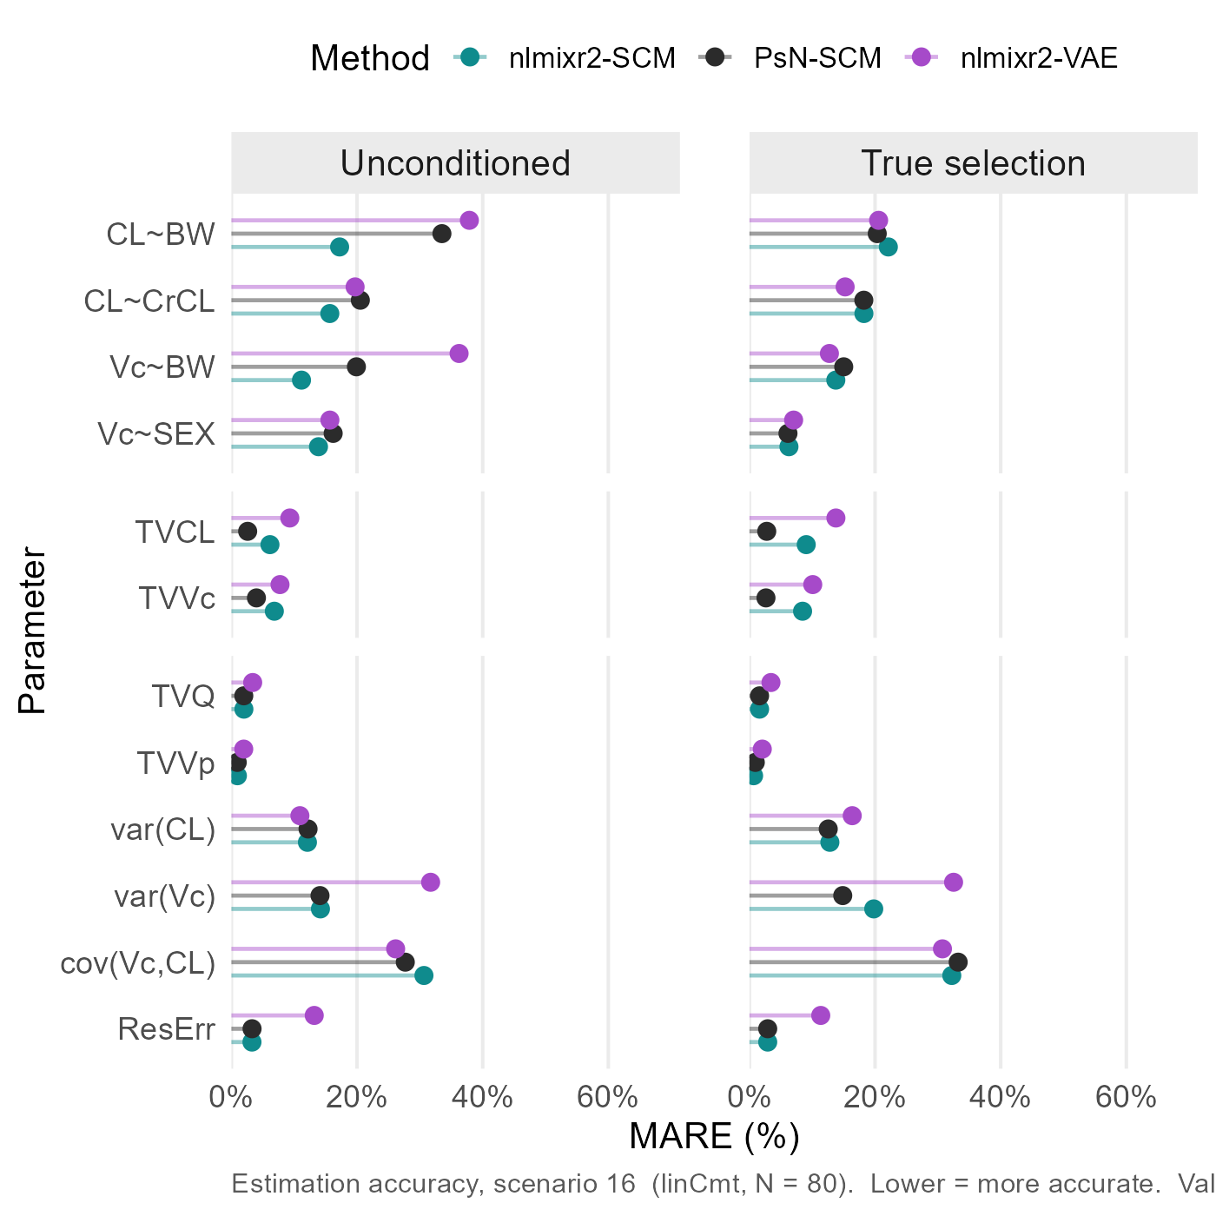
Estimation accuracy is comparable across nlmixr2, NONMEM, and VAE
Scn16 + N80 + Analytic
Estimation accuracy: nlmixr2-SCM $≈\text{PsN}\text{_}\text{SCM}≈\text{nlmixr}\text{2}\text{−}\text{VAE}$
1 Reliability
2 Power
3 Accuracy
4 Runtime

Slide 24
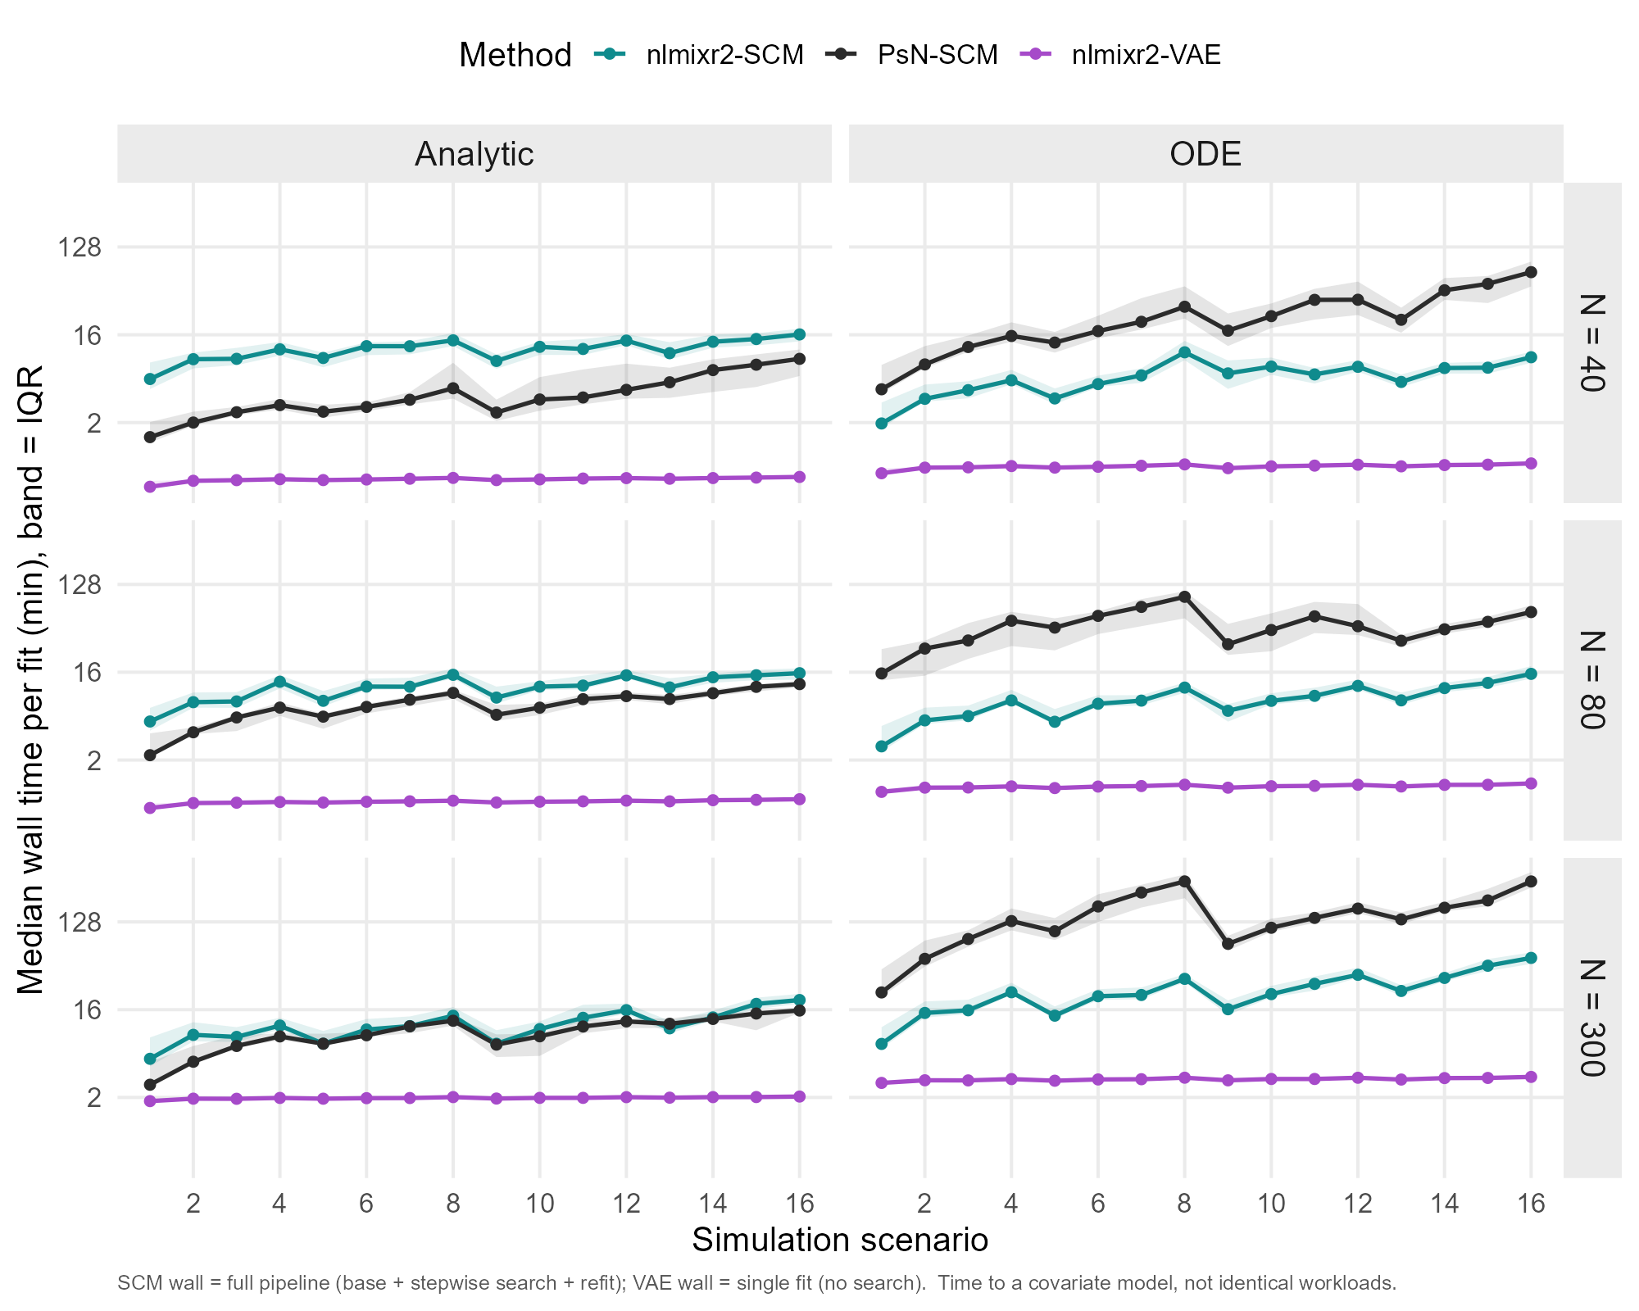
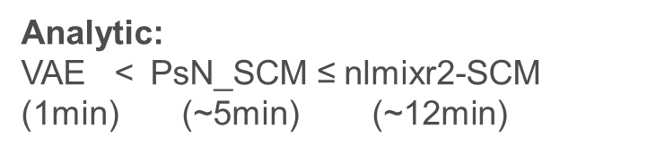
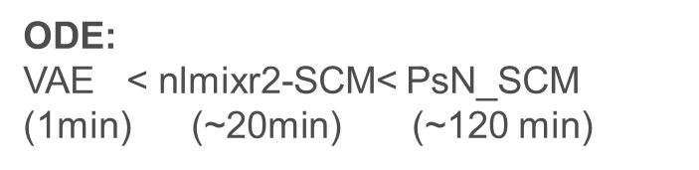
The VAE can be substantially than NONMEM-SCM_ODE
4 CPU cores
Log Scale
Run time:
VAE << nlmixr2 < NONMEM
Analytic << ODE
sample size ↓, runtime ↓
Analytic:
VAE < $\text{PsN}\text{_}\text{SCM}$ ≤ nlmixr2-SCM (1min) (~5min) (~12min)
ODE:
VAE < nlmixr2-SCM< $\text{PsN}\text{_}\text{SCM}$ (1min) (~20min) (~120 min)
1 Reliability
2 Power
3 Accuracy
4 Runtime
24

Slide 25
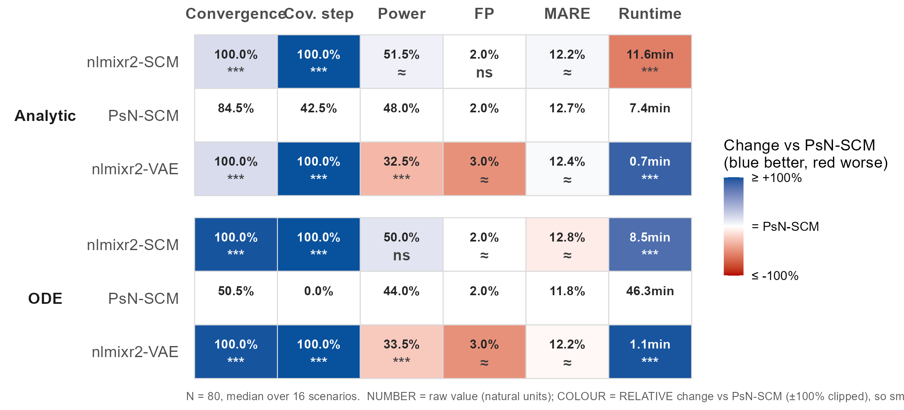
Scorecard: nlmixr2 –SCM matching NONMEM, with VAE being substantially faster
Number is median over 16 scenarios (natural units), Colored by relative change vs PsN-SCM (method-PsN)/PsN
***statistically significant Beta_method ≠ 0 & meaningfully different; ≈, statistically significant but not meaningfully different (<±10%)

Slide 26
1 Background
2 Methods
3 Results
4 Discussion
26

Slide 27
Collinearity and Small samples remain the main challenges
Competing shapes + Collinearity confound selection
→ Domian knowledge/clinical significance/biological plausibility
Small N sharply reduces power
→ Interpret covariate models cautiously for early phase clinical trials
Analytic solution > ODE
Turn on 1D profile-based warm up for complex ODE
27

Slide 28
Open-source nlmixr2 SCM matches/outperforms NONMEM
SCM:
Comparable power & accuracy
Faster; Better Reliability; Open source
SCM
VAE：
Production Estimation
Extremely Faster; Open source
Comparable power & accuracy for easy covariate space
28
Notes:
To conclude.
In this benchmark, the open-source nlmixr2-SCM matched or outperformed PsN-NONMEM-SCM. It gave comparable power and estimation accuracy, better reliability, faster runtimes for ODE models — and it is open source.
The VAE's strength is speed, with comparable accuracy and reasonable power in the easier covariate scenarios.
So the take-home message is this. nlmixr2-SCM is a credible open-source alternative to NONMEM-SCM.
And the VAE is a promising fast screening method that can complement traditional SCM — though not yet replace it in high-stakes confirmatory settings.

Slide 29
References
1.Lane S, Al-Zubiedi S, Hatch E, et al. The population pharmacokinetics of R- and S-warfarin: effect of genetic and clinical factors. Br J Clin Pharmacol. 2012;73(1):66-76. doi:10.1111/j.1365-2125.2011.04051.x
2. Ribbing J, Nyberg J, Caster O, Jonsson EN. The lasso--a novel method for predictive covariate model building in nonlinear mixed effects models. J Pharmacokinet Pharmacodyn. 2007;34(4):485-517. doi:10.1007/s10928-007-9057-1
3. Karlsen M, Khier S, Fabre D, et al. Covariate Model Selection Approaches for Population Pharmacokinetics: A Systematic Review of Existing Methods, From SCM to AI. CPT Pharmacometrics Syst Pharmacol. 2025;14(4):621-639. doi:10.1002/psp4.13306
4. Jonsson EN, Karlsson MO. Automated covariate model building within NONMEM. Pharm Res. 1998;15(9):1463-1468. doi:10.1023/a:1011970125687
5. Rohleff J, Bachmann F, Nahum U, et al. Redefining Parameter Estimation and Covariate Selection via Variational Autoencoders: One Run Is All You Need. CPT Pharmacometrics Syst Pharmacol. 2025;14(12):2232-2243. doi:10.1002/psp4.70129
6. Ahamadi M, Largajolli A, Diderichsen PM, et al. Operating characteristics of stepwise covariate selection in pharmacometric modeling. J Pharmacokinet Pharmacodyn. 2019;46(3):273-285. doi:10.1007/s10928-019-09635-6
7. https://github.com/nlmixr2/nlmixr2/blob/main/vignettes/articles/vaeNeonatal.Rmd

Slide 30
Acknowledgement
Matt Fidler
Justin Wilkins and the rest nlmixr2 development team
PMX, PKS, AQS team
Talent acquisition team
Fellow interns
Notes:
I am very grateful to my manager, Matt Fidler — this project would not have been possible without his guidance and support.
Thank you to Justin Wilkins, the other primary developer of the nlmixr2 SCM package, and to the whole nlmixr2 development team, whose commitment to open science genuinely inspired me.
Thank you to the PMX, PKS, and AQS teams, especially those who shared their career journeys with me, and to the talent acquisition team and my fellow interns for making this internship so memorable.

Slide 31
Thank you for your attention! Any questions?

